Slide 1
LINUX BASICS

Slide 2
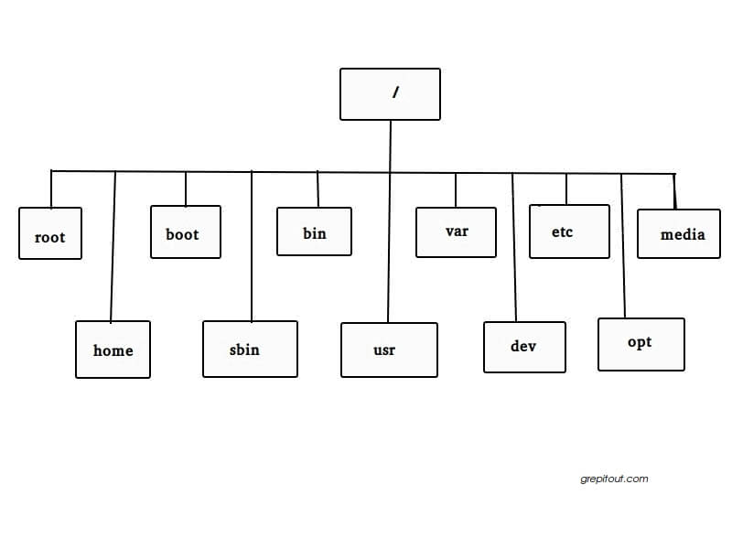
File-system Hierarchy
A file system is a logical collection of files on a partition or disk
Linux uses a hierarchical file system structure, much like an upside-down tree
Linux filesystem is a collection of files and directories.

Slide 3
/ - This is the root directory which should contain only the directories needed at the top level of the file structure.
/root - home directory of root user.
/home - Contains the home directory for users and other accounts.
/bin - This is where the executable files are located
/etc - Supervisor directory commands, configuration files, disk configuration files
/tmp - Holds temporary files used between system boots

Slide 4
Users and Groups
Three types of accounts on a Linux system:
Root User: Have complete and unfettered control of the system. Root user can run any commands without any restriction.
System Users: Those needed for the operation of system-specific components
User accounts: General users are typically assigned to these accounts and usually have limited access to critical system files and directories.
A normal user will only have access in their home directory.
Sudo
Allows a permitted user to execute a command as the superuser or another user.
Add a normal user to sudoer file to get sudo permission.
/etc/sudoers
Append sudo before a command to run it as superuser.

Slide 5
GROUP:
Linux operating system is designed to allow more than one user to have access to the Linux system at a time.
Group is logically groups a number of user accounts.
When a user a created a group with same name as that of username is also created automatically. That user will only be the member of that group by default.
Create a new user:
useradd command adds a new user to the system.
It creates a new user with userid(UID) and also a group with groupid (GID).
A home directory for the user is created at /home.
$ useradd testuser
$ id testuser uid=1000(testuser) gid=1000(testuser)
You can change the password of user using passwd command. $ passwd username
groupadd command creates a new group in the system. $ groupadd groupname

Slide 6
Basic Commands
Linux Shell: A shell is a program that receives commands from the user and gives it to the OS to process.
Syntax
command [option] [arguments]
Basic Commands:
pwd - command prints the absolute path to current working directory $ pwd /home/user
echo - This command will echo whatever you provide it. $ echo "linux" linux
man - To see a command's manual page $ man date

Slide 7
cd - Change the current working directory to the directory provided as argument.If no argument is given to ‘cd’, it changes the directory to the user's home directory. $ pwd /home/raghu $ cd /usr/share/ $ pwd /usr/share
ls - List files and/or directories
ls -l - displays a long listing of the files.
ls -a - shows hidden files in directory. $ ls [files-or-directories] $ ls -l total 4 drwxr-xr-x 2 user user 4096 2012-07-06 12:52 example -rw-r--r-- 1 user user 0 2012-07-06 12:52 file1.txt

Slide 8
mkdir - To create a directory $ mkdir example
touch - For creating an empty file $ touch file1
cp - Copy files and directories $ cp usrlisting listing_copy.txt
mv - Move files or directories $ mv source destination
rm - remove files and directories $ rm files|directories
cat - concatenator but can be used to view the contents of a file $ cat /etc/passwd root:x:0:0:root:/root:/bin/bash daemon:x:1:1:daemon:/usr/sbin:/bin/sh

Slide 9
head - Displays the first few lines of a file. $ head /etc/passwd root:x:0:0:root:/root:/bin/bash daemon:x:1:1:daemon:/usr/sbin:/bin/sh bin:x:2:2:bin:/bin:/bin/sh
tail - Shows the last 10 lines by default. $ tail -n 2 /etc/passwd raghu:x:1000:1000:Raghu Sharma,,,:/home/raghu:/bin/bash sshd:x:113:65534::/var/run/sshd:/usr/sbin/nologin
grep - searches for a pattern in a file $ grep nologin /etc/passwd sshd:x:113:65534::/var/run/sshd:/usr/sbin/nologin
ln - create links, links are a kind of shortcuts to other files.There are two types of links, soft links and hard links $ ln TARGET LINK_NAME

Slide 10
EDITORS
VI : Standard editor in many Linux.
Default editor that comes with many Linux distributions. $ vi hello.txt
The vi editor has 3 modes in which it performs its functions.The default is COMMAND mode: in which tasks like copy, paste, undo etc can be performed. INSERT mode: in which whatever key you type is treated as a character and will be loaded into the file buffer. To enter this mode, press ‘i’ when in command mode.
EX mode or last line mode. The changes made in the buffer can be saved or discarded in this mode.To get into it, press Esc and then : (the colon)

Slide 11
Nano: Nano is a modeless editor so you can start typing immediately to insert text
$ nano filename
to save the changes you've made, press Ctrl + O.
To exit nano, type Ctrl+ X. If you ask nano to exit from a modified file, it will ask you if you want to save it. Just press N in case you don't, or Y in case you do.
It will then ask you for a filename. Just type it in and press Enter
Gedit: The default GUI text editor
$ gedit filename

Slide 12
FILE PERMISSIONS
File ownership is an important component of Unix that provides a secure method for storing files.
Every file in Unix has the following attributes:
Owner permissions − The owner's permissions determine what actions the owner of the file can perform on the file.
Group permissions − The group's permissions determine what actions a user, who is a member of the group that a file belongs to, can perform on the file.
Other permissions − The permissions for others indicate what action all other users can perform on the file.
$ ls -l /home/user/test.txt
-rwxr-xr-- 1 ubuntu ubuntu 1024 Nov 2 00:10 test.txt
The permissions are broken into groups of threes: read (r), write (w), execute (x)

Slide 13
Changing Permissions:
To change the file or the directory permissions, you use the chmod (change mode) command.
$ ls -l testfile -rwxrwxr-- 1 user users 1024 Nov 2 00:10 testfile
chmod o+wx testfile
$ ls -l testfile -rwxrwxrwx 1 user users 1024 Nov 2 00:10 testfile
Changing Owners and Groups:
The chown command changes the ownership of a file $ chown user file.txt
The value of the user can be either the name of a user on the system or the user id (uid) of a user on the system.
The chgrp command changes the group ownership of a file. $ chgrp groupname file.txt
The usermod command adds an Existing User to a Group. $ usermod -a -G username groupname

Slide 14
virtualenv

Slide 15
IDE

Slide 16
Assignment
Complete the assignment in linux test pdf.

